Slide 1
EARTHQUAKE NOWCASTING IN INDONESIA: ANALYSIS OF INTEREVENT COUNT DISTRIBUTIONS
Presented by:
Tukey group

Slide 2
WHAT IS EARTHQUAKE NOWCASTING?
Before understanding what Earthquake Nowcasting is, let us first describe what earthquake is, so, Earthquake is a term used to describe both sudden slip on a fault, and the resulting ground shaking and radiated seismic energy caused by the slip, or by volcanic or magmatic activity, or other sudden stress changes in the earth.
In simple terms we can say, earthquake is basically “when the earth, quakes (i.e. shakes, or trembles)”.
Now, coming to what is earthquake nowcasting?
The goal of nowcasting is to determine the current state of the fault system, or put another way, the current state of progress through the earthquake cycle. This is in contrast to forecasting, which is the calculation of probabilities of future large earthquakes.

Slide 3
WHAT IS EARTHQUAKE PREDICTION? AND HOW IS IT DIFFERENT FROM FORECASTING?
Earthquake prediction is a branch of the science of seismology concerned with the specification of the time, location, and magnitude of future earthquakes within stated limits, and particularly "the determination of parameters for the next strong earthquake to occur in a region
Earthquake prediction is sometimes distinguished from earthquake forecasting, which can be defined as the probabilistic assessment of general earthquake hazard, including the frequency and magnitude of damaging earthquakes in a given area over years or decades. Not all scientists distinguish "prediction" and "forecast”, but it is useful.
We utilize concept of natural time analysis.

Slide 4
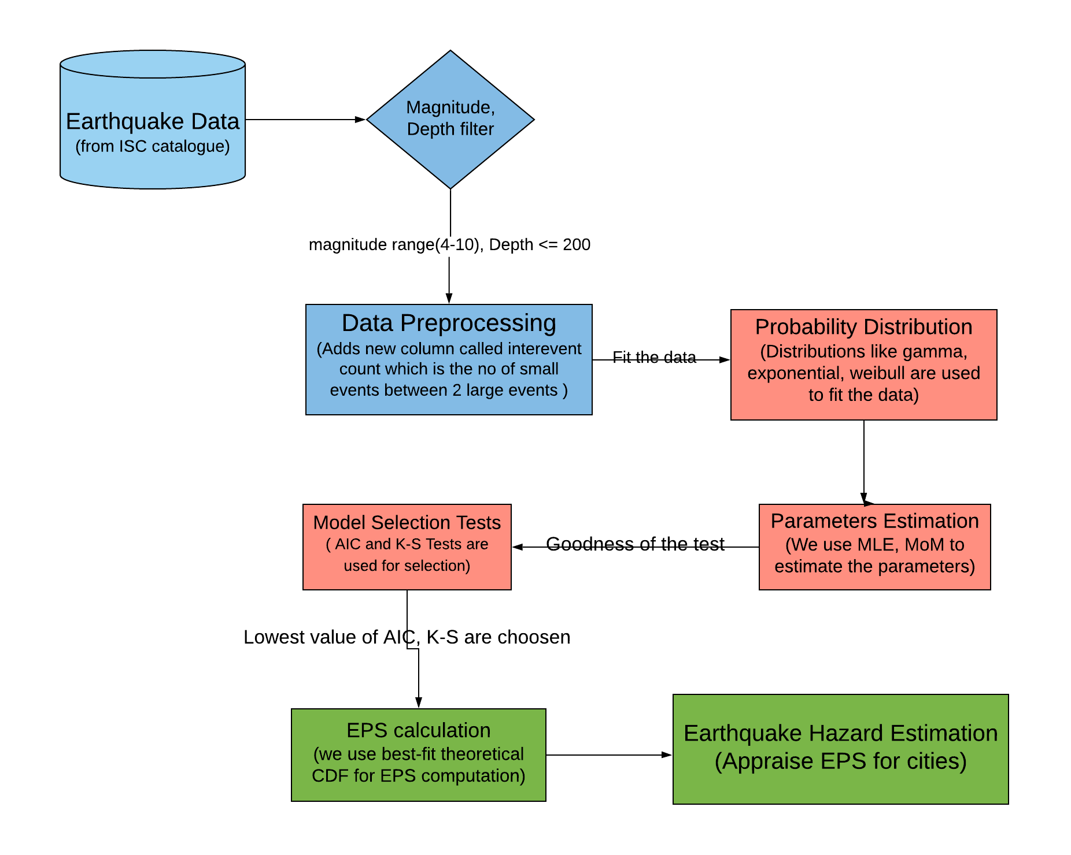
Methodology

Slide 5
HOW WE DID IT?
Task1
Getting to know the assignment
What we have to do, and what we should be knowing before attempting the assignment and getting the Data.
Task2
Data Preprocessing
Discard those cases where the interevent count is 0.
Count the interevent counts between large earthquakes.
Our Plan
Task3
Fit the probability distributions
The Distributions we worked with: Exponential, Gamma, and Weibull.
And for estimating the parameters, we used, MLE.
Task4
Prioritize the candidate probability distributions.
We used two goodness of fit tests for the same, AIC, K-S.
Task5
Based upon the probability distribution that we chose to work with, estimation of EPS (Earthquake potential Score) was done.
Task6
Based upon the EPS Score, we interpreted the results.
And now, we are presenting.

Slide 6
DATA PREPROCESSING
Taking random variable as the number of non-zero Interevent count between. Tabulating the inter-event counts of small earthquakes[4<=M<6] between two large events[M>=6] in the Sumatra and adjacent region, we obtain an independent and identically distributed random sample X1; X2; ...; X154 of size 154.
Column1 | DATE | LAT | LON | DEPTH | MAG | inter_event_count
1 | 04-02-1971 | 0.567 | 98.7275 | 33.2 | 6.3
2 | 08-04-1971 | -4.346 | 102.2394 | 71.2 | 6.5 | 13
3 | 04-05-1971 | -6.6056 | 105.3776 | 52.5 | 6 | 2
4 | 07-04-1973 | 6.9809 | 91.3906 | 27.3 | 6 | 97
5 | 27-02-1974 | 1.2916 | 97.5406 | 32.8 | 6.1 | 42
6 | 17-05-1974 | -6.5702 | 106.694 | 136.3 | 6 | 13
7 | 07-09-1974 | -9.927 | 108.3914 | 30.1 | 6.1 | 21
8 | 10-10-1974 | -4.1998 | 102.7002 | 49.3 | 6 | 8
9 | 09-11-1974 | -6.4385 | 105.3658 | 53.4 | 6.2 | 7

Slide 7
FITTING THE PROBABILITY DISTRIBUTIONS
The observed natural time of 154 earthquake counts.We find that the sample mean inter-event count is 116.4351, with a sample standard deviation of 147.9375. The data are clearly asymmetric (right-skewed) with a skewness of 2.805128.
Taking random variable as the number of non-zero Interevent count between, we fit 6 distributions namely Weibull , Lognormal, gamma , exponential, inverse gaussian and inverse weibull using R’s fitdistrplus package
We estimated model parameters from the maximum likelihood estimation (MLE)

Slide 8
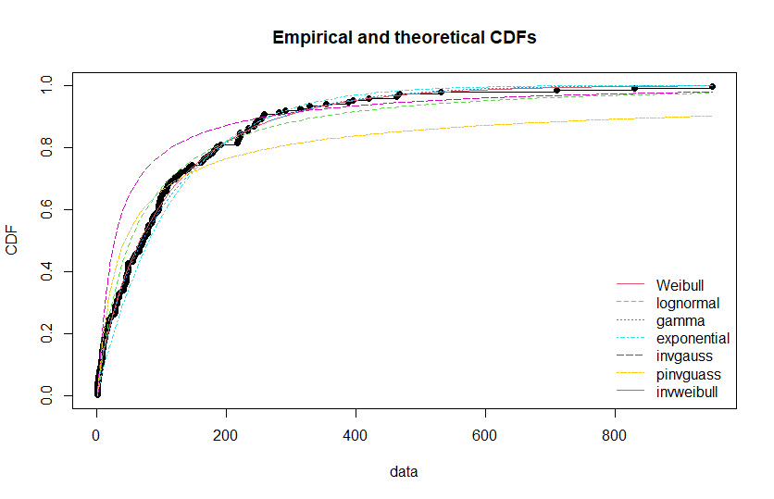
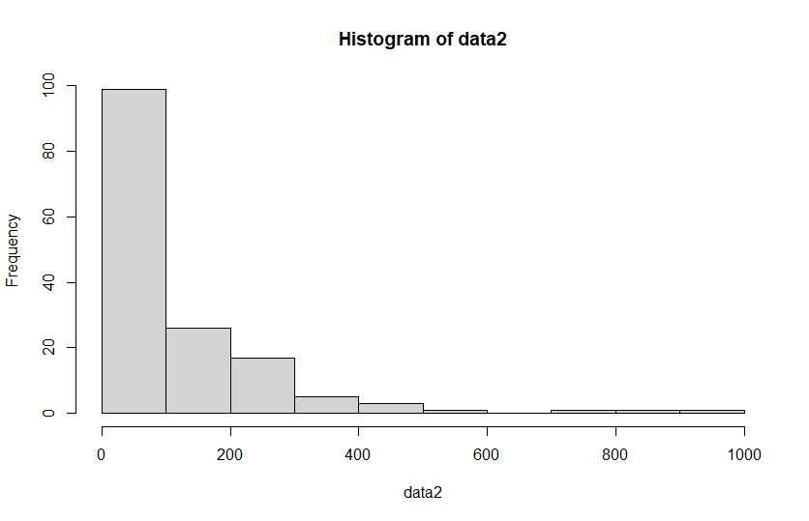
Here, data = Natural Times

Slide 9
PRIORITIZING WHICH DISTRIBUTION TO WORK WITH
We performed the Kolmogorov Smirnov Test using the Parameters from summary of each distribution to find the D statistic and the P-values, and from those D-statistic we came to a conclusion that the Weibull Distribution, is preferable to work with, since in k-s test, D-statistic for weibull distribution came around 0.03759309 which is the lowest among all distributions and it shows that we fail to reject null hypothesis i.e. Ho- distribution is weibull.
Another test we performed was goodness of fit tests using gofstat function to get AIC parameters and from there also we interpreted weibull as the best distribution as AIC value of weibull was lowest and lower the AIC value,better the fit.

Slide 10
PRIORITIZING CONTINUES….
PROBABILITY DISTRIBUTIONS
AIC VALUES
K-S TEST VALUES
Weibull Distribution
1766.124
0.03759309
1
Lognormal Distribution
1781.089
0.09747253
2
Gamma Distribution
1767.617
0.05116617
3
Exponential Distribution
1775.259
0.1035174
4
Inverse-Gaussian Distribution
1839.459
0.2649661
5
Inverse-Weibull Distribution
1829.420
0.1503573
6

Slide 11
CALCULATING THE EPS SCORE
The cumulative distribution of the best-fit model when evaluated for the current number of small earthquake counts in a selected small area (e.g., cities) provides us with the numerical earthquake potential score (EPS) or the nowcast value for the region.
Now on nowcasting earthquakes for two cities, Aceh and Medan, having the current small event counts are 275 and 400, respectively, and using the Weibull Distribution. We got:
EPS_Aceh_275 = 0.8908246
EPS_Medan_400 = 0.9508177

Slide 12
RESULTS AND INTERPRETATION
Kolmogorov Smirnov Test and the Akaike information criterion both suggested that the Weibull Distribution is good to work with.
And on using the Weibull Distribution we got the following Earthquake Potential Score:
EPS_Aceh_275 = 0.8908246
EPS_Medan_400 = 0.9508177
This means that Aceh region has progressed 89% of the way to the next large[M>=6] earthquake and Medan has progressed 95%.

Slide 13
NOTE OF THANKS
Mentor : Dr. Sumanta Pasari.
Thanks for guidance and the opportunity that you gave us. It wouldn’t have been possible without your guidance, sir.

Slide 14
THANK YOU...

